Slide 1
2022 Hilly Hundred Weekend Bicycle Tour Communications and SAG BRIEFING
Monroe County ARES-RACES Group
Bloomington Amateur Radio Club
Indiana University Amateur Radio Club
Monroe County Repeater Association
Central Indiana Bicycling Association
(CIBA)
Notes:
43

Slide 2
Agenda
Hilly dates and times
Friday (21 Oct) evening briefing
Net Control Station personnel
Saturday and Sunday assignments
Route
SAGs
Stationary Hams and Rest Stops
Duties and responsibilities
Net operations
Checklists
Notes:
<number>

Slide 3
2022 Hilly Hundred Weekend
Friday Evening, 21 October
Saturday, 22 October
Sunday, 23 October
Notes:
<number>

Slide 4
Friday Evening 21 October
Meet at Edgewood HS
Pick up volunteer packets after 5 PM
Final briefing at 7 PM
Meet at NCS, Room B128 (Chorus/Choir Room) – opens to South.
Notes:
<number>

Slide 5
Edgewood Schools Campus Ellettsville

Slide 6

SATURDAY
22 October

Slide 7
Edgewood HS Net Control Station (NCS)
Saturday & Sunday
7:00 -17:00
A.J. Ragusa KC9EVU
Pete Becker, NU9W
Anthony Parker, N9OIU
Notes:
<number>

Slide 8
SAG Operations
07:30 – 16:30
Saturday, 21 Oct
ALPHA Dave Hall KB9EKM
BRAVO Russ Bonanno KD9SMG
CHARLIE Tom Meyers K9TEM
DELTA Tim Day AC9ML
ECHO Mike Foster K9MBF
HOTEL Ray Stevens KB9LGS
KILO Don Kirk WD8DSB
LIMA Bob Burns AK9R
MIKE Mike Foster N9FEB
COM ONE Tom Henderson W9YW
Notes:
<number>

Slide 9
Little Hilly Route

Slide 10
HH2022Saturday Short Route
Saturday Short Route

Slide 11
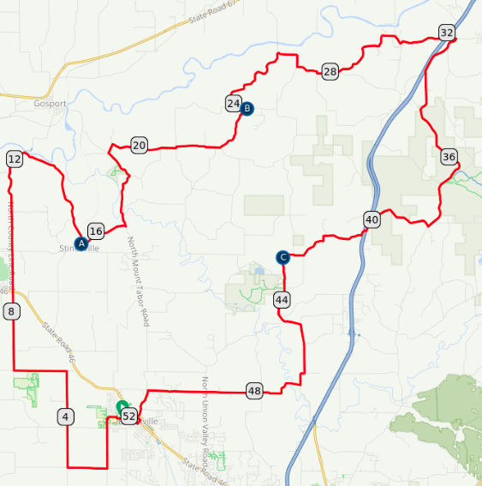
Hilly Hundred 2022 Saturday Long Route

Slide 12
Rest Stop 1 Stinesville
Matt Pierce N9VKU
Dave Stolz KD9KZS
Carol Emmons KD9BSJ
Spt: 08:00 – 14:00
RS: 09:00 – 13:00
Snacks, fruit, and water
Victor Oolitic Park
39 17.94 N, 086 39.13 W
Rest Stop Captain: Natalie Mitchell, 317.640.9261
Notes:
<number>

Slide 13
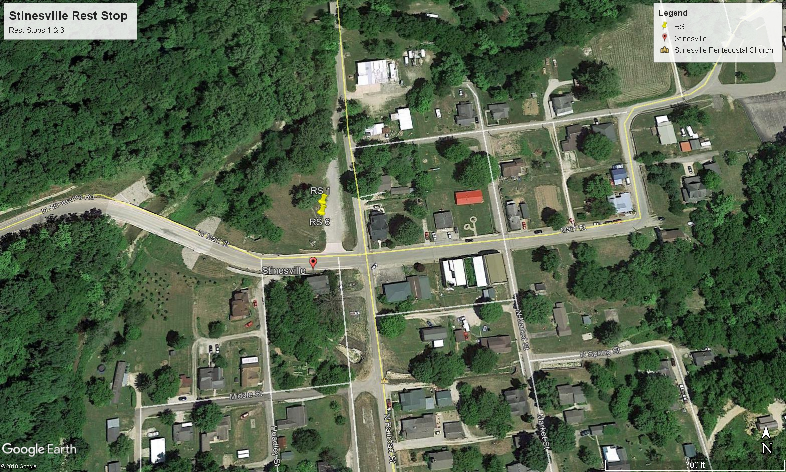

Slide 15
Rest Stop 2 - Saturday Lunch
Bob Poortinga W9IZ
Richard Landgrebe WB9HXP
Spt: 09:00 – 15:00
RS: 10:00 – 14:00
Lunches, fruit and water
39 20.90 N, 086 34.38 W
Notes:
<number>

Slide 16
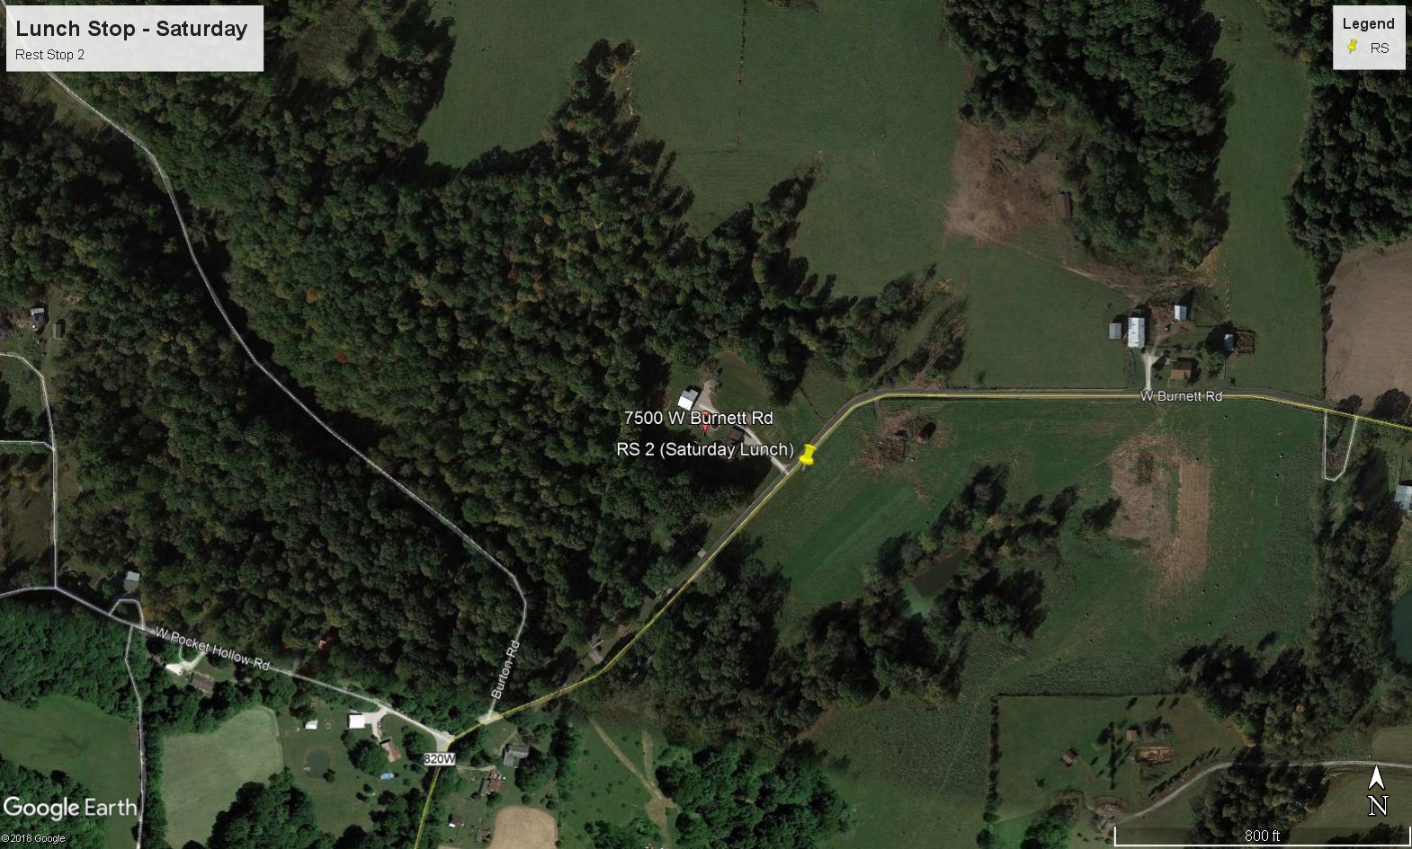

Slide 18
Rest Stop 3
1392 W Dittemore Rd
Anurag Shankar KD9LSP
John Poehlman N9TFS
Carol Emmons KD9BSJ
Spt: 10:00 – 16:00
RS: 11:00 – 15:00
Snacks, fruit and water
39° 17.72 N, 086 ° 33.13 W
Notes:
<number>

Slide 19
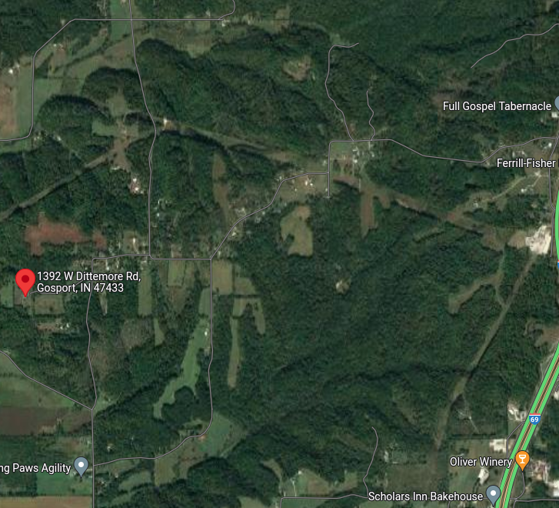
NEW RS 3 Saturday

Slide 20
SUNDAY
23 October

Slide 21
SAG Operations
07:30 – 16:30
Sunday, 10 Oct
ALPHA Dave Hall KB9EKM
BRAVO Russ Bonanno KD9SMG
CHARLIE Tom Myers K9TEM
DELTA Tim Day AC9ML
ECHO Mike Foster K9MBF
HOTEL Ray Stevens KB9LGS
KILO Don Kirk WD8DSB
LIMA Bob Burns AK9R
MIKE Mike Palmer N9FEB
COM ONE Tom Henderson W9YW
Notes:
<number>

Slide 22
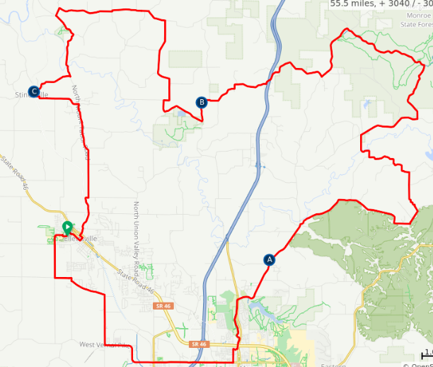
Sunday Long Route

Slide 23
HH 2022 Sunday Short Route
Sunday Short Route

Slide 24
Rest Stop 4 Bloomington Twp Fire Dept 5081 N Old State Road 37
Anurag Shankar KD9LSP
John Poehlman N9FTS
Carol Emmons KD9BSJ
Spt: 08:00 – 14:00
RS: 09:00 – 13:00
Snacks, fruit, and water
39° 13.46’ N 086° 31.00’ W
Notes:
<number>

Slide 25
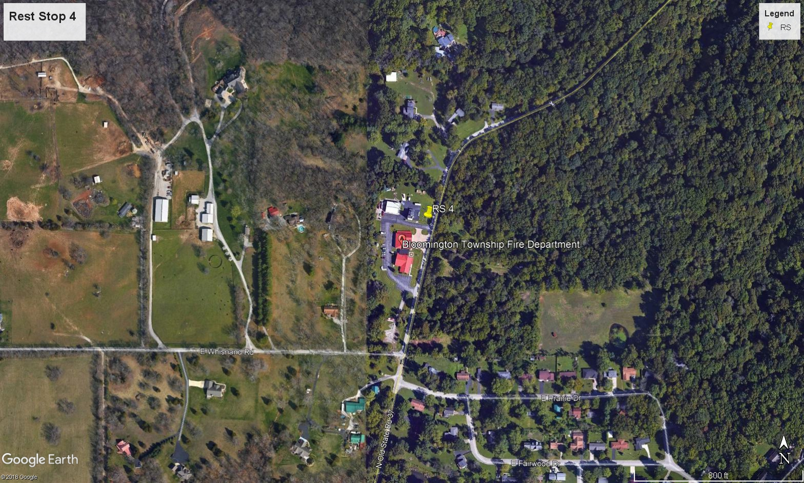

Slide 26
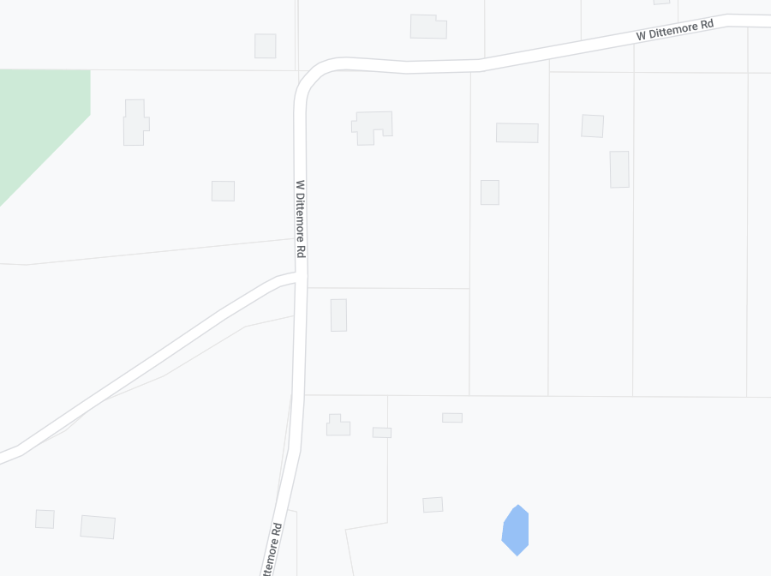
Entrance – North
Exit – South
Warning: 2-Way
1392 W Dittemore Rd
Entrance
Hilly Sunday Rest Stop #4

Slide 27
Rest Stop 5 Sunday Lunch
Tom Poortinga W9IZ
Richard Langrebe WB9HXP
Spt: 09:00 – 15:00
RS: 10:00 – 14:00
Lunches, fruit, and water
39° 17.72 N, 086° 33.13’ W
Rest Stop Captain: Denise Mattox, 317.345.8074
Notes:
<number>

Slide 28
NEW Rest Stop 2 Sunday

Slide 29
Rest Stop 6 Stinesville
Dave Stolz KD9KZS
Matt Pierce N9VKU
Bill Wootton KC9ACL
Spt: 10:00 – 16:00
RS: 11:00 – 15:00
Snacks, fruit, and water
39° 17.94’ N 086° 39.13’ W
Rest Stop Captain: Pat Madaras, 317.946.7696
Notes:
<number>

Slide 32
Duties and Responsibilities
CIBA is responsible for operation of Hilly Hundred Weekend events.
Amateur Radio operators are responsible for communications.
SAG duties are part of CIBA structure, but hams acting as SAGs are also part of the Communications structure.
Remember to keep your dual responsibilities separate!
We’re Amateur Radio Licensees, ambassadors of our hobby. Please be kind, courteous, alert, and flexible.
Notes:
<number>

Slide 33
Net Operations
The Net Control Operator
Organize traffic to and from remote stations
Communicate information to and from CIBA Command Center and CIBA volunteers on the route
Direct traffic between radio amateurs on the route and on station to best serve needs of CIBA
Maintain and operate the Net Control Station to best serve needs of radio amateurs, IAW FCC regulations.
Set the example with proper proword usage!
Rotate NCS operators to keep them fresh! Maintain schedule
The Hilly Hundred Net
Operate on WB9TLH repeater - 146.640 (-600, PL 136.5)
Secondary: K9IU repeater – 147.180 (+600, PL 136.5)
Tactical - 146.580 Simplex
Directed Net.
All communications through or with permission of NCS
Morning ‘Wet Net’ and incidental contacts with permission
Encourage ‘third party’ and ‘go direct’ contacts to facilitate communication
Non-routine net traffic may be designated as ARRL welfare, priority or emergency by sending stations and may use ARRL message format for clarity and a written record.
Notes:
<number>

Slide 34
Net Operations (cont)
Accuracy and Brevity
Limit transmissions to no more than 20-30 seconds, pause between transmissions to allow traffic of higher priority to be passed. Logging both incoming and outgoing messages facilitates accuracy and brevity.
Keep the main frequencies clear; ask to go to simplex for non-event or informational traffic.
Keep an HT on simplex to approach Rest Stops and Edgewood HS.
Program your radios before you arrive, please.
Use proper prowords, such as “Over” and “Out”.
Tactical Call signs
Use tactical call signs whenever possible to provide clarity
SAG A, SAG B, etc.
FCC regulations require full call sign ID at the end of each contact (and/or at 10 minute intervals).
Use tactical callsigns to refer to Rest Stops and other SAG radio operators
Notes:
<number>

Slide 35
Net Operations (cont)
For example:
Net Control, this is Rest Stop One, over.
Net Control, over.
Rest Area One [message], over.
Net Control, Roger, [message reply], over.
Rest Stop One, [callsign], out.
See Carl, KB9RVB’s slide presentation (Feb 2012) for more info:
Monroe Co. ARES-RACES Group Basic Operator Course – Unit 3

Slide 36
Net Operations (cont) Direct Contact and Third Party Traffic
The following tactics can save valuable airtime and are often more accurate than voice relays through the NCS.
Direct Contact
NCS will honor requests for “…permission to go direct with [callsign].” Similar to National Traffic System (NTS) “Tactical dispatching,” except for expediency, the transmitting station, rather than the receiving station, initiates the direct call. Called station will end Direct Contact with “[callsign] over and calling station will end with“[callsign] out”.
Third Party Traffic
When passing traffic between non-hams (such as between a CIBA official and a CIBA volunteer) or between a ham and a non-ham, operators may use “third party traffic” techniques to facilitate the information exchange.
The control operator should inform the third party of FCC rules, instruct them to keep transmissions short, and maintain control of the PTT switch.
Hams operating Third Party Traffic will clear with “[callsign] ending third party traffic, over.”
If possible, use “formal” NTS messages and ARRL Radiograms with the ham reading the traffic.
Use rider tag information, not names
Keep a cool head in difficult situations; breathe; talk distinctly and slowly so that you can be understood.
Notes:
<number>

Slide 37
Net Operations (cont) Emergency Traffic
ARRL Message Form
In times of emergency, radiograms may be used to communicate information critical to saving lives or property or to inquire or learn about the health or welfare of a disaster victim. During these times, NTS works in concert with ARES and other emergency and disaster relief organizations. In some cases, the message form also serves as a log of the operation.
Code and Ciphers
Amateur radio operators may not hide the meaning of communications by putting them in codes or ciphers – except for a few specific exceptions cited in FCC Part 97. CW is one of the exceptions; another is the ARRL “numbered Radiograms.” These may prove useful for events. However, since this is a “phone” net, reading the entire Radiogram may be cumbersome. Balance the use of these numbered communications for instances in which accuracy and radio security are more important than expediency.
Numbered Radiograms
We use an adapted list – ONE through TWENTY-SIX [see list]
Notes:
<number>

Slide 38
ARRL Numbered Radiograms for Emergency Use [adapted]
ONE -- Everyone safe here. Please don't worry.
TWO -- Coming home as soon as possible.
THREE -- Am in ____ hospital. Receiving excellent care and recovering fine.
FOUR -- Only slight property damage here. Do not be concerned about disaster reports.
FIVE -- Am moving to new location. Send no further mail or communication. Will inform you of new address when relocated.
SIX -- Will contact you as soon as possible.
EIGHT -- Need additional _____ mobile or portable equipment for immediate emergency use.
NINE -- Additional _____ radio operators needed to assist with emergency at this location.
TEN -- Please contact ______. Advise to standby and provide further emergency information, instructions or assistance.
ELEVEN -- Establish Amateur Radio emergency communications with ______ on _____ MHz.
THIRTEEN -- Medical emergency situation exits here.
FOURTEEN -- Situation here becoming critical. Losses and damage from ____ increasing.
FIFTEEN -- Please advise your condition and what help is needed.
SIXTEEN -- Property damage very severe in this area.
EIGHTEEN -- Please contact me as soon as possible at _______.
NINETEEN -- Request health and welfare report on______. (State name, address and telephone number.) [Transmit this ONLY after request from NCS.]
TWENTY -- Temporarily stranded. Will need some assistance. Please contact me at ______.
TWENTY ONE -- Search and Rescue assistance is needed by local authorities here. Advise availability.
TWENTY TWO -- Need accurate information on the extent and type of conditions now existing at your location. Please furnish this information and reply without delay.
TWENTY THREE -- Report at once the accessibility and best way to reach your location.
TWENTY FOUR -- Evacuation of residents from this area urgently needed. Advise plans for help.
TWENTY SIX -- Help and care for evacuation of sick and injured from this location needed at once.

Slide 39
SAG Hams
SAG Hams will provide communications between CIBA Command Center/NCS and SAGs
either as a ride-along ham, or
as SAG driver/ham
SAG Hams are obligated to maintain his/her station consistent with FCC regulations and best ham practices.
SAG Hams may use 146.58 to facilitate traffic with stationary hams at rest stops and critical points, when within range.
Watch traffic carefully at all times; be situationally aware.
Let traffic behind you go around you when you find a SAFE place to pull over.
Use headlights and flashers at all times you’re on the course

Slide 40
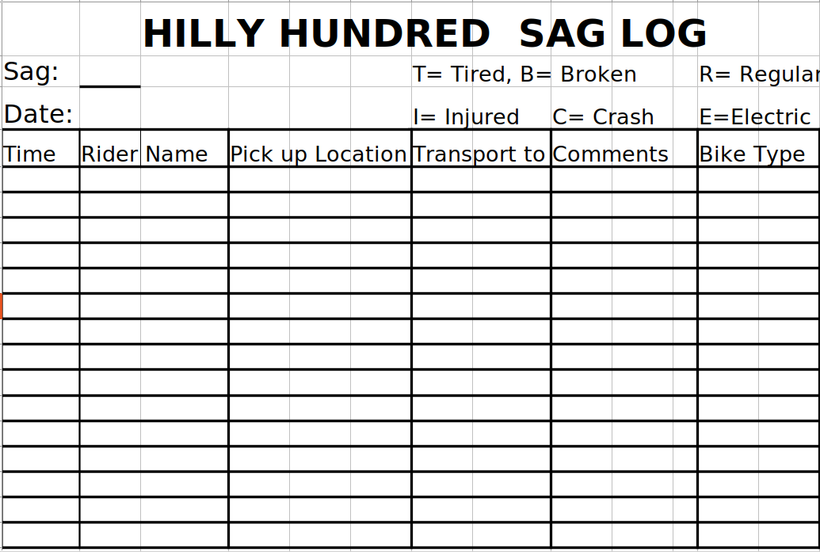

Slide 41
Stationary Hams
Communications to and from rest stops and critical points will be handled through stationary radio operators.
Each Stationary Ham will check in with the rest stop captain not later than the posted opening time and advise that the ham:
will organize traffic to and from the CIBA workers at the rest stop and the CIBA Command Center,
will maintain communication between Command Center and CIBA SAGs, and
will pass traffic from bicyclists to and from Command Center.
It is the duty of the Stationary Ham to maintain and operate the remote station in a manner consistent with FCC regulations and best ham practice.
Stationary hams may use 146.58 for internal traffic and traffic with approaching SAGs—maintain a watch on this frequency!

Slide 42
Hams’ Personal Supplies
Hilly Hundred Weekend assignments and duties create different scenarios for each operator’s need for personal supplies.
Monroe County ARES-RACES members have an “Emergency Response Preparation” list which can be adapted to Hilly Hundred assignments.
ARRL provides suggestions for such supplies in publications and at the www.arrl.org website.
Operators assigned to a critical location or reassigned to meet tactical needs may not have ready access to food and water. Be prepared.
Mobile ham/SAGs will travel between rest stops, but will probably not have much time to rest! Lunch is sent for SAG Hams, and RS2 and RS3 but not RS1.
If you have specific meal times or meal requirements, pack sufficient food and liquids as back-up to meals available on the route. Do not rely on meals being delivered by the mobile operators--SAGs are responsible for supporting the riders.
Keep Important Meds With You and Safe!
Notes:
<number>

Slide 43
ARES-RACES Deployment Checklist
Radio Equipment
HT (or mobile) with 2-meter TxRx capability
Multi-band HTs should have at least 70 cm TxRx and wide-band Rx capability.
Appropriate portable/mobile gain antenna, connections and adapters
Earphone and/or speaker mic
Extra batteries and auxiliary power adapters
Other
Pen, paper (including log sheets) and clipboard
Call sign and location roster.
Cell & emergency phone numbers.
Local maps [incl maps supplied by CIBA]
Bicycle rack
Still More Stuff …
Identification:
Laminated wallet-sized copy of the FCC amateur operator/station license
ARES and/or RACES photo ID card
CIBA Hilly Hundred Volunteer card and meal wristband
Signage: BARC Communications - Hilly Hundred-supplied SAG, Communications, First Aid kit
Appropriate clothing, sunscreen, insect repellent, camp stool or folding chair
Extra food and water.
Appropriate prescriptions and necessary OTC drugs. It is a good idea to carry some description of any personal physical or medical condition that may be needed to assist you in an emergency.
Cooler and dry pack.
Notes:
<number>

Slide 44
Questions?
Thank you for your service!
Tom Henderson W9YW
317.250.4646
W9YW@ARRL.NET

